Slide 1

ANUGERAH KHIDMAT SETIA (AKS)
Transfer of Technology and Knowledge
20 Nov 2023

Slide 2

Agenda
Background & Project Description
Project Scope
System Overview
System Information

Slide 3
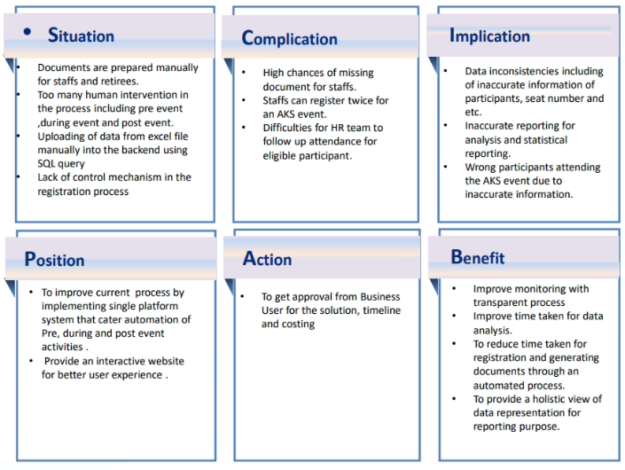
ANUGERAH KHIDMAT SETIA (AKS)

Slide 4
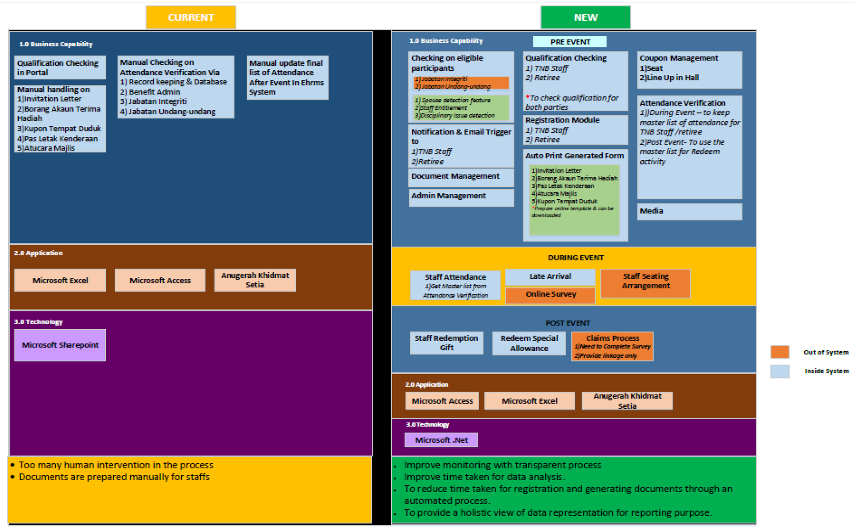
Project Scope
OLD

Slide 5
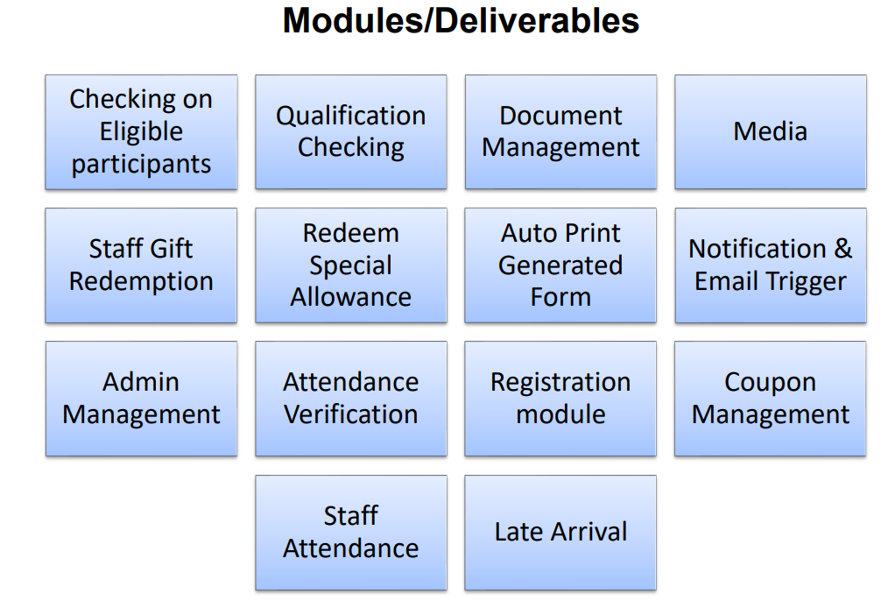
Project Scope

Slide 6
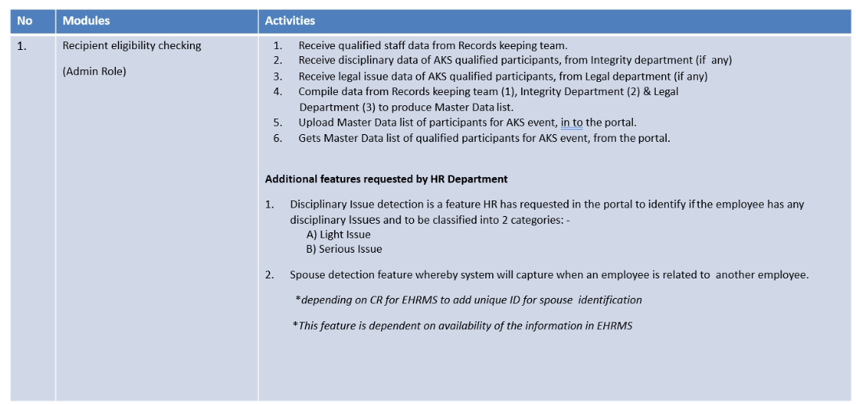
Project Scope

Slide 7
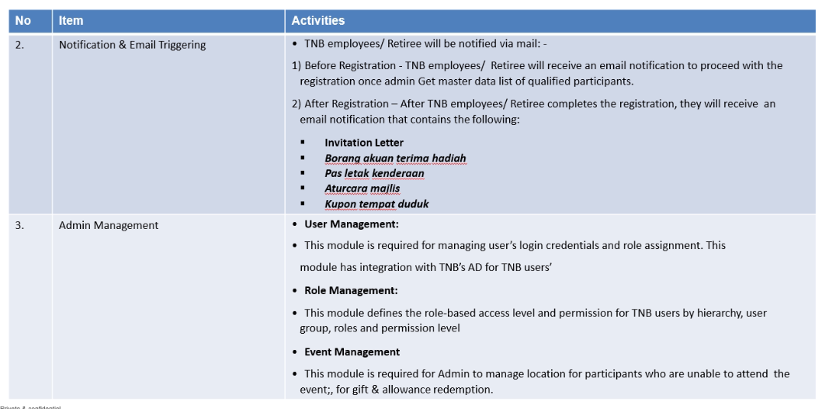
Project Scope

Slide 8
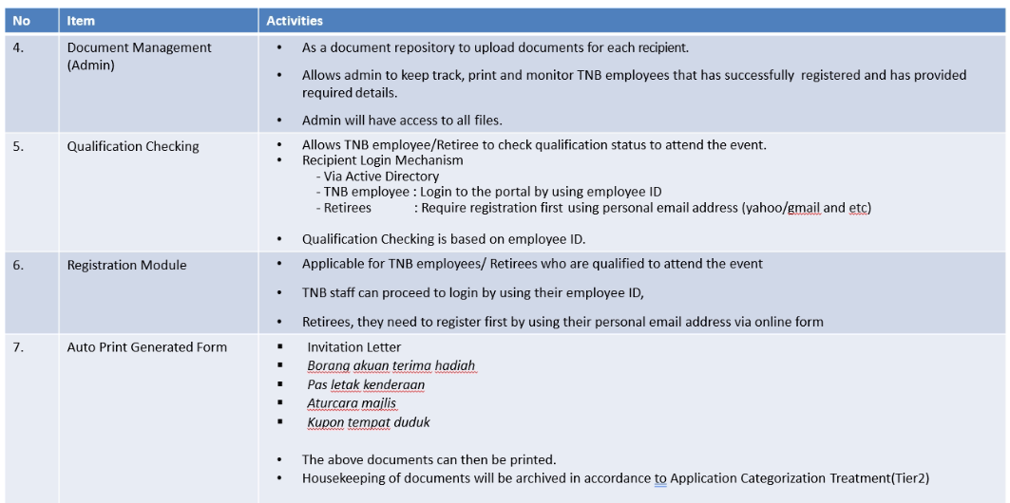
Project Scope

Slide 9
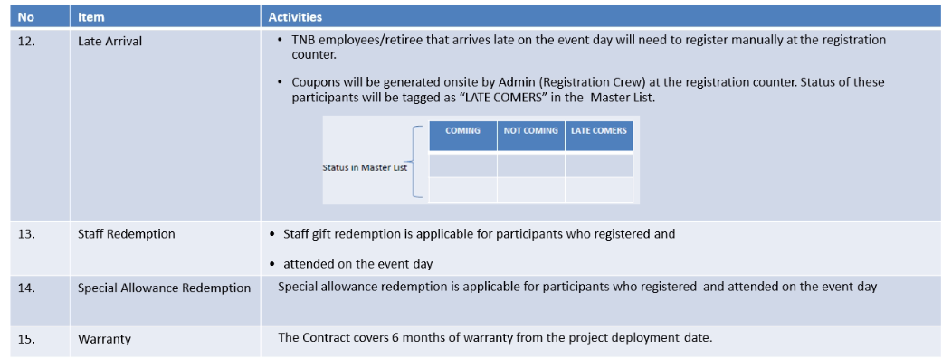
Project Scope

Slide 10
System Overview
Agenda:
Pass
New Item / Pending

Slide 11
System Overview Checklist
No | Description | Role | If Okay / Not Okay
1 | Landing Page | All
2 | Check Eligibility Staff or Retiree Status | All
3 | Link Email for Staff & Retiree | Staff & Retiree
4 | Retiree Login Page | Retiree
5 | Verification Staff Personnel Number And Create Password | Staff & Retiree
6 | Retiree & Staff | Staff & Retiree
7 | Attendance Form | Staff & Retiree
8 | Tidak Hadir Display | Staff & Retiree
9 | Recipient’s Photo | Staff & Retiree
10 | Display Image Of Staff | Staff & Retiree
11 | Attendance Proof | Staff & Retiree
12 | Tidak Hadir Page | Staff & Retiree
13 | Hadir Page | Staff & Retiree
14 | Pdf Slip Bukti Kehadiran | Staff & Retiree

Slide 12
System Overview Checklist
No | Description | Role | If Okay / Not Okay
15 | User Management | AJK,Staff & HR
16 | HR Main Page | HR
17 | Upload Latest Staff | Admin & Hr
18 | Staff List | Admin & Hr
19 | Department List | Admin & Hr
20 | Staff Award History | Admin & Hr
21 | Recipient Profile | Admin & Hr
22 | Leaves Special Case List | Admin & Hr
23 | Legals Special Case List | Admin & Hr
24 | Discipline Special Case List | Admin & Hr
25 | Masterlist List | Admin & Hr
26 | Event List | Admin & Hr
27 | Initial Screening | Admin & Hr
28 | Upload Excels | Admin & Hr

Slide 13
System Overview Checklist
No | Description | Role | If Okay / Not Okay
29 | Final Screening | Admin & Hr
30 | Session Allocation | Admin & Hr
31 | List Of Finalized Recipients | Admin & Hr
32 | Event Tentative | Admin & Hr
33 | Attendance Confirmation Feedback | Admin & Hr
34 | Pre-event Statistic (Statistic Of Recipients&statistic Of Attendance Reply Feedback) | Admin & Hr
35 | Attendance Confirmation During Event | Admin & Hr
37 | Attendance Statistic for All Eligible During Event | Admin & Hr
38 | Unclaimed Gifts Statistic During Event | Admin & Hr
39 | List of Finalized Recipients’ Attendance | Admin & Hr
40 | Event Gallery | Admin & Hr

Slide 14
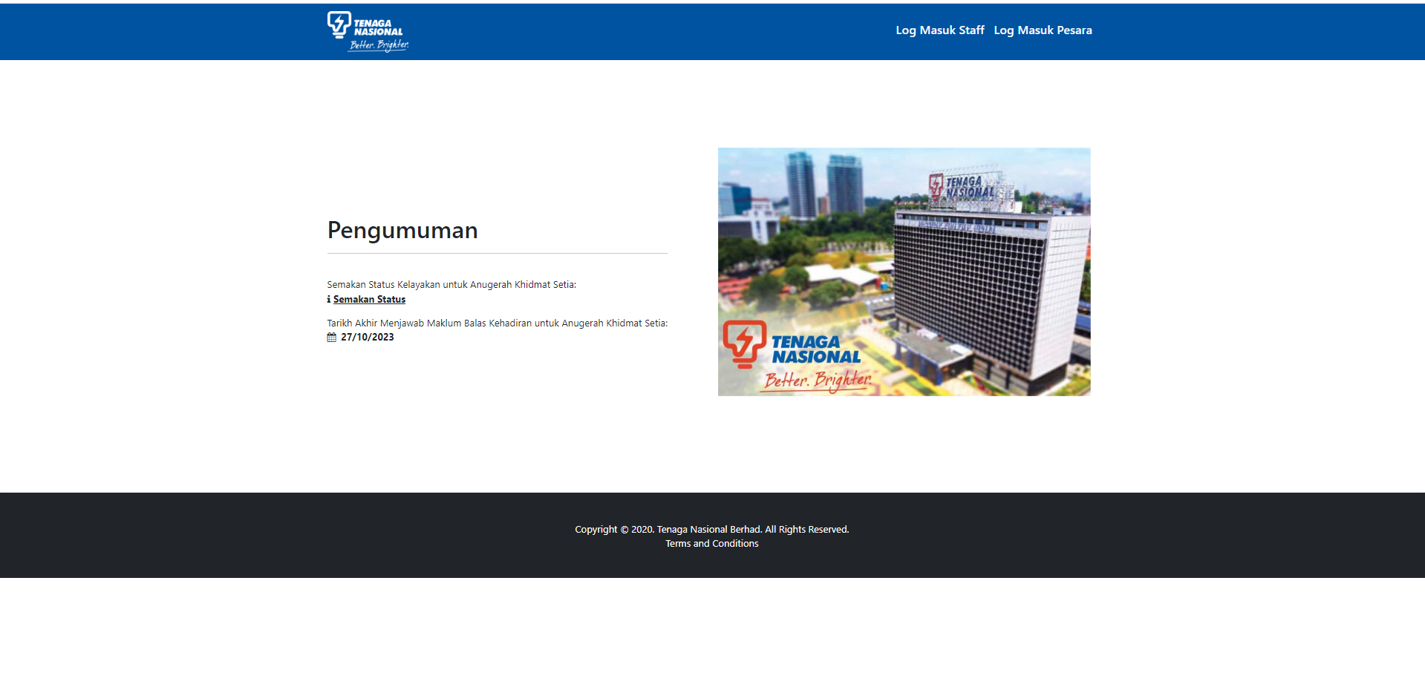
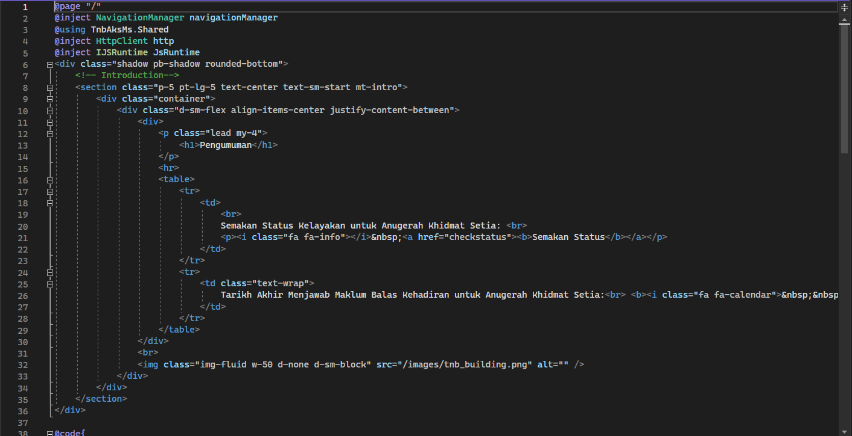
Landing Page
Coding Page
File Location
TnbAksMs/Client/Pages/Index.razor

Slide 15
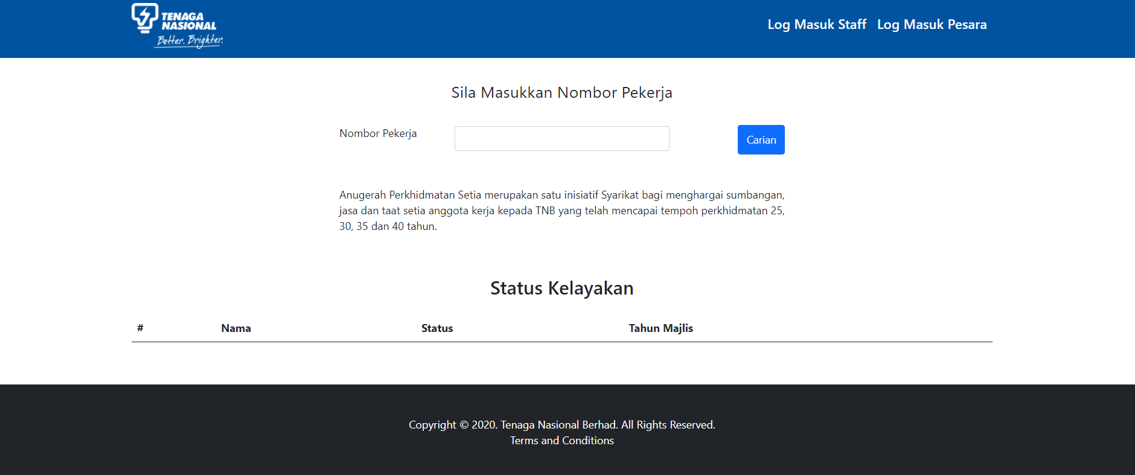
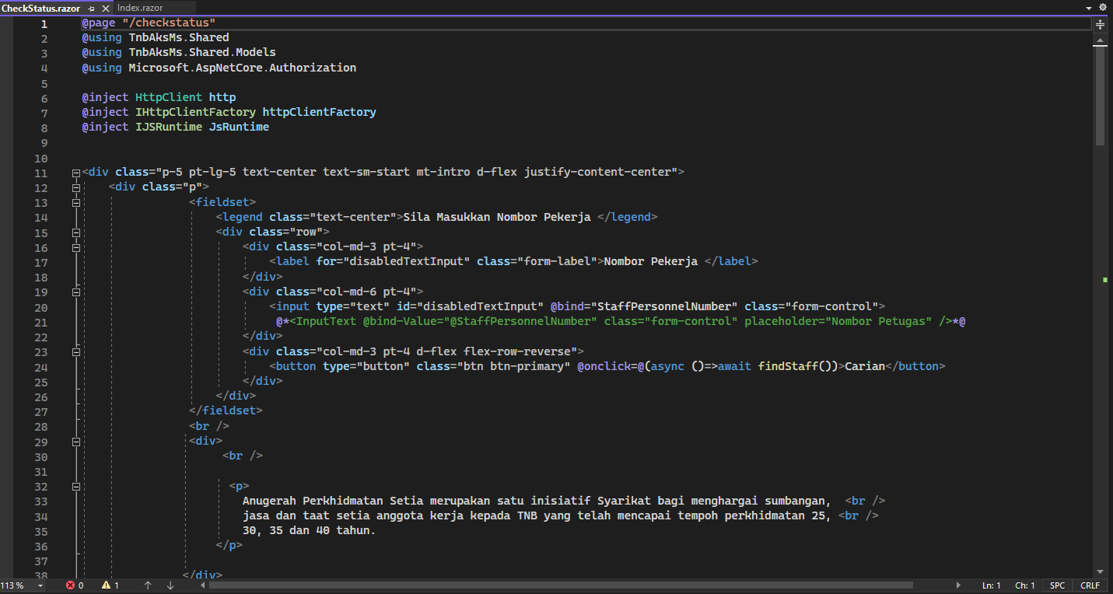
Check Eligibility Staff or Retiree Status
Coding Page
File Location
TnbAksMs/Client/Pages/CheckStatus.razor

Slide 16
Staff & Retiree
CODING PAGE AKS AND FILE LOCATION

Slide 17
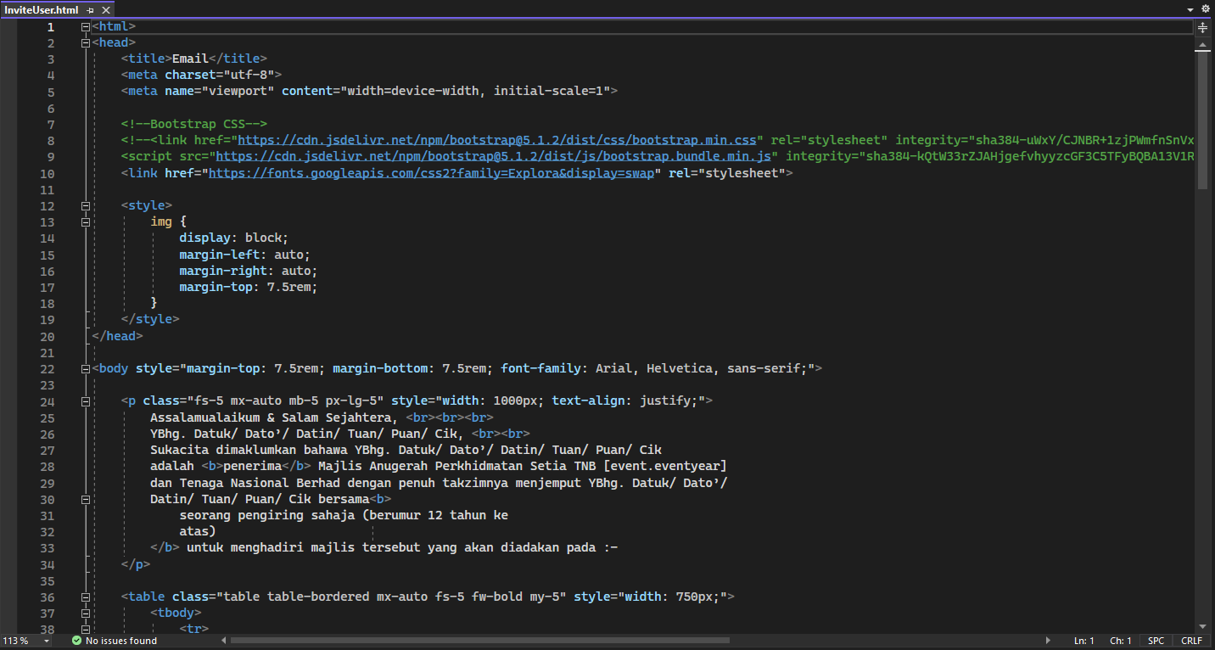
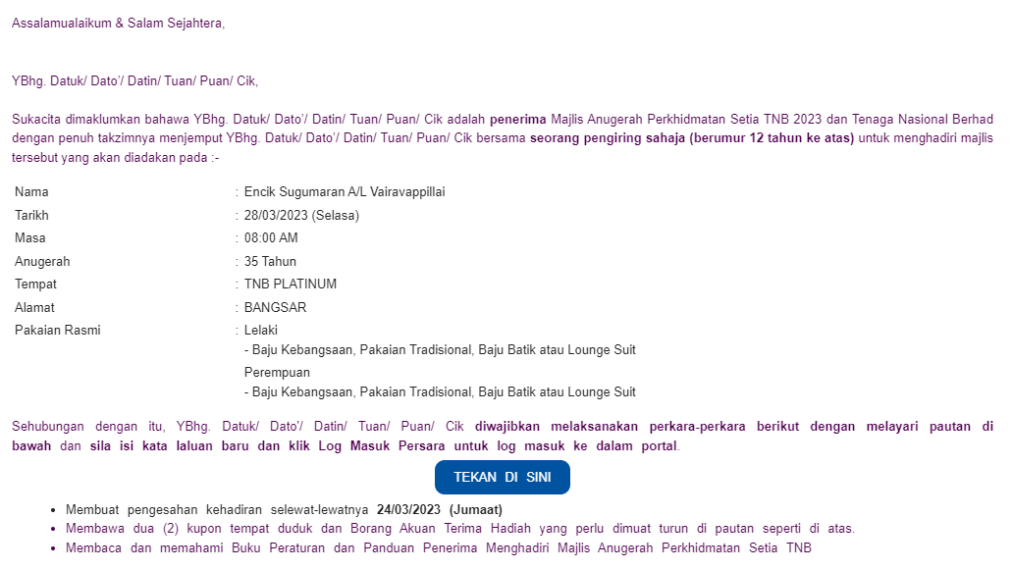
Link Email For Staff & Retiree
Coding Page
File Location
TnbAksMs/Server/EmailTemplates/InviteUser.html

Slide 18
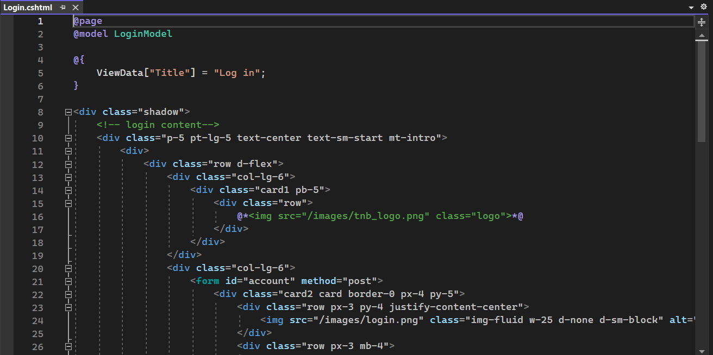
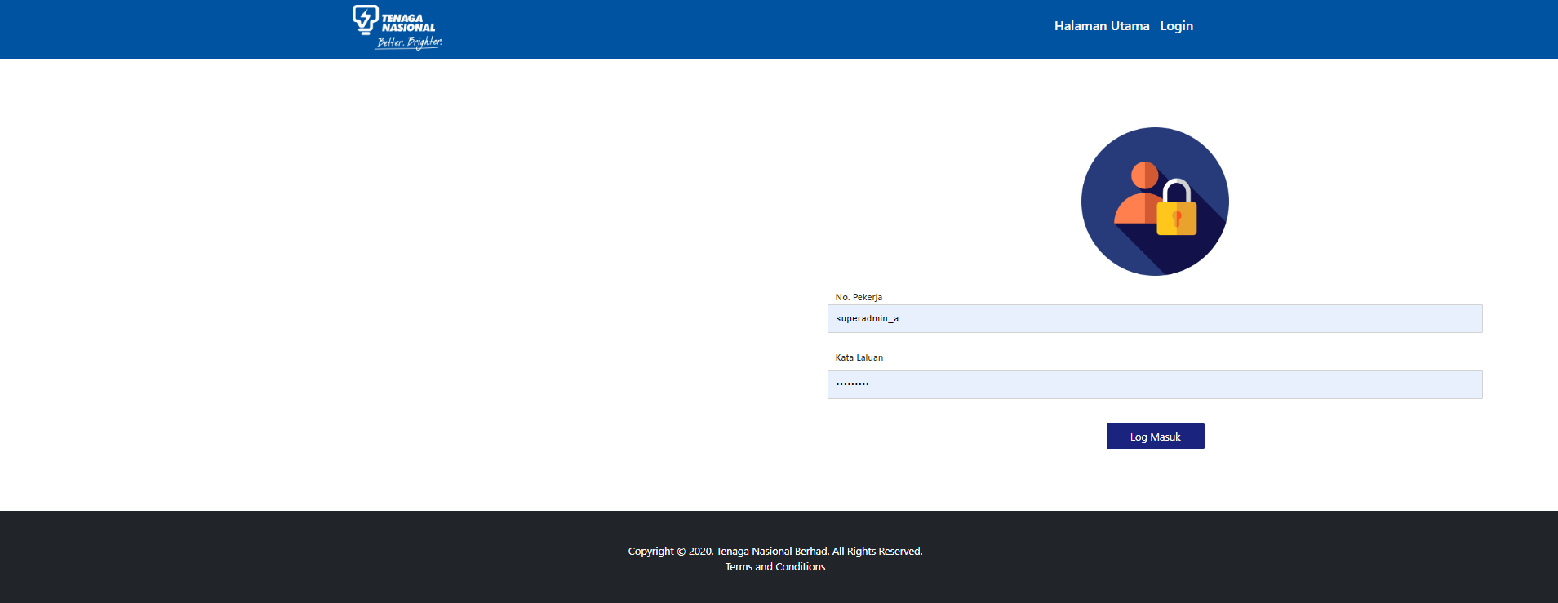
Retiree Login Page
Coding Page- Retiree
File Location
TnbAksMs/Server/Areas/Identity/Pages/Account/Login.cshtml

Slide 19
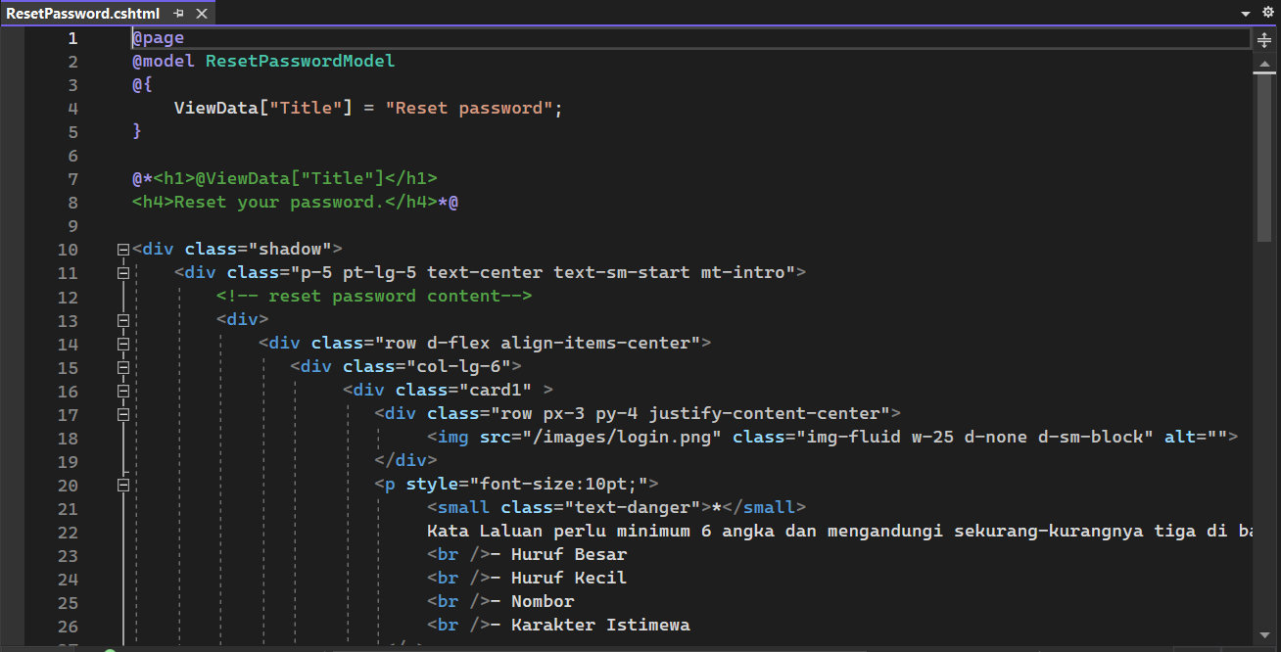
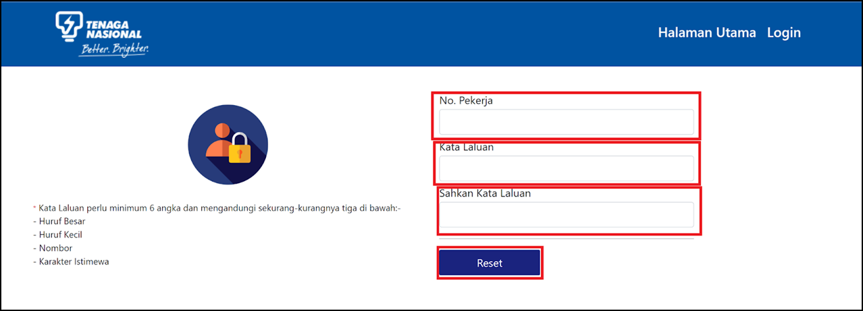
Verification Staff Personnel Number and Create Password
Coding Page
File Location
TnbAksMs/Server/Areas/Identity/Pages/Account/ResetPassword.cshtml

Slide 20
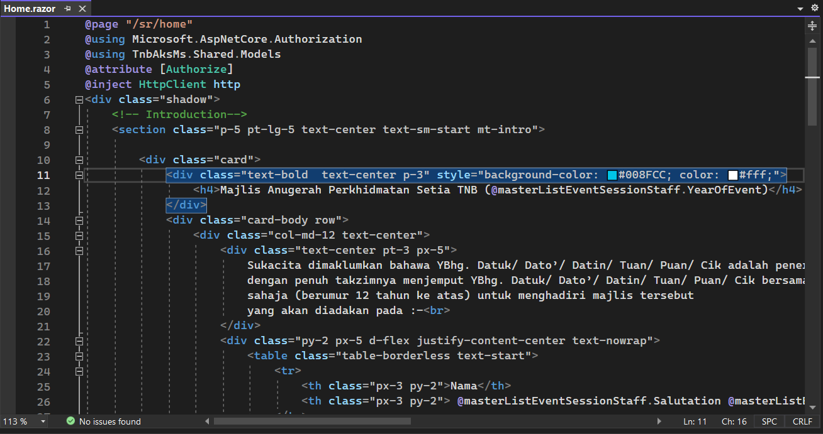
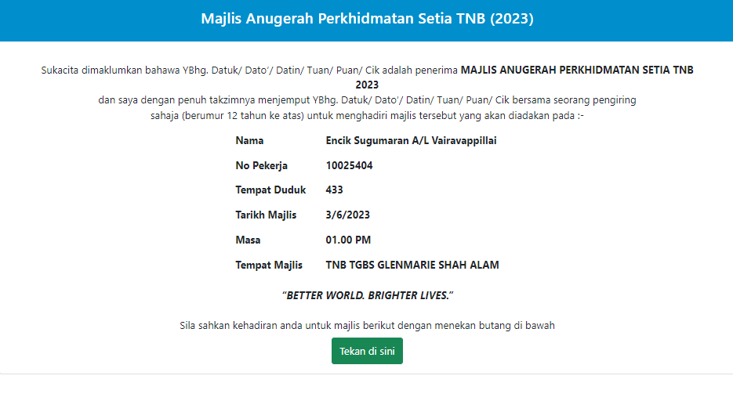
Retiree & Staff
Coding Page
File Location
TnbAksMs/Client/Pages/Sr/Home.razor

Slide 21
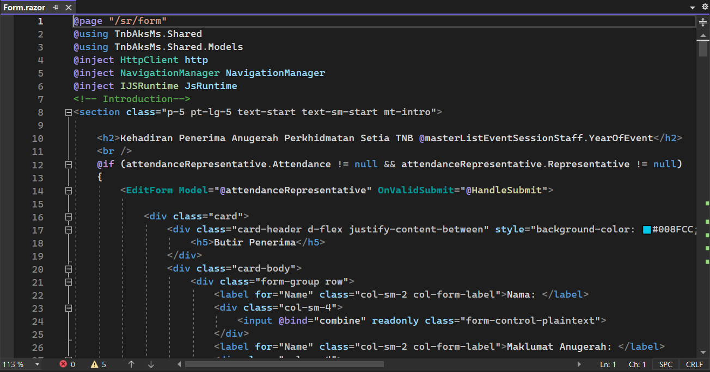
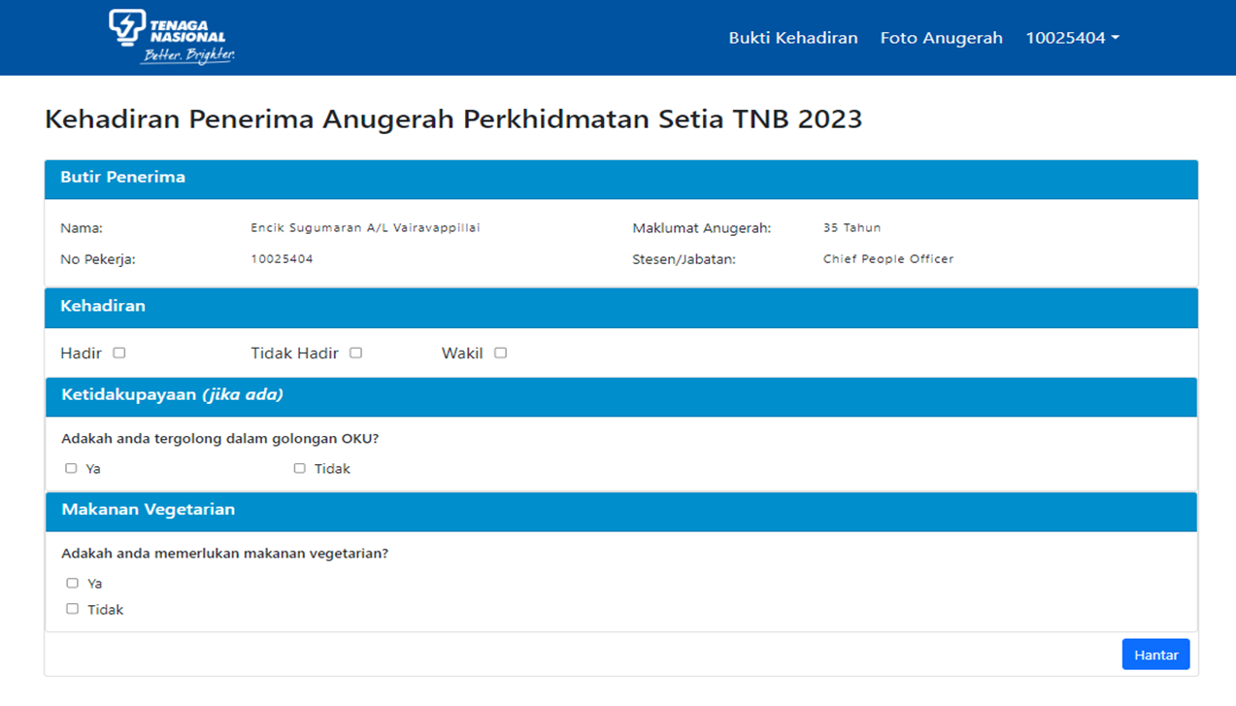
Attendance form
Coding Page
File Location
TnbAksMs/Client/Pages/Sr/Form.razor

Slide 22
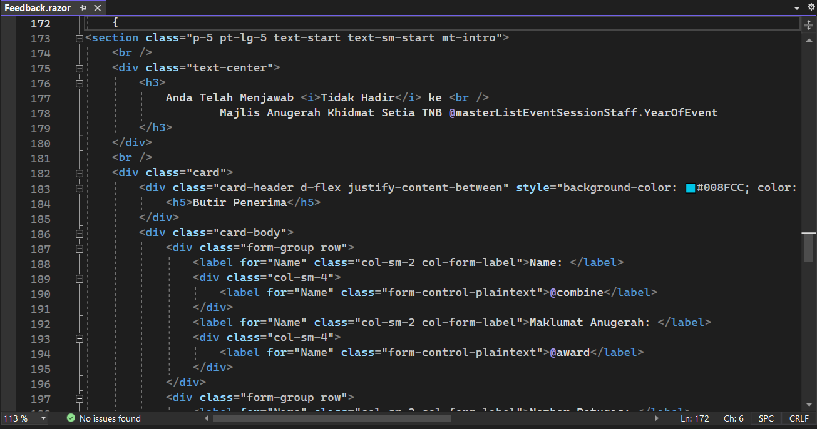
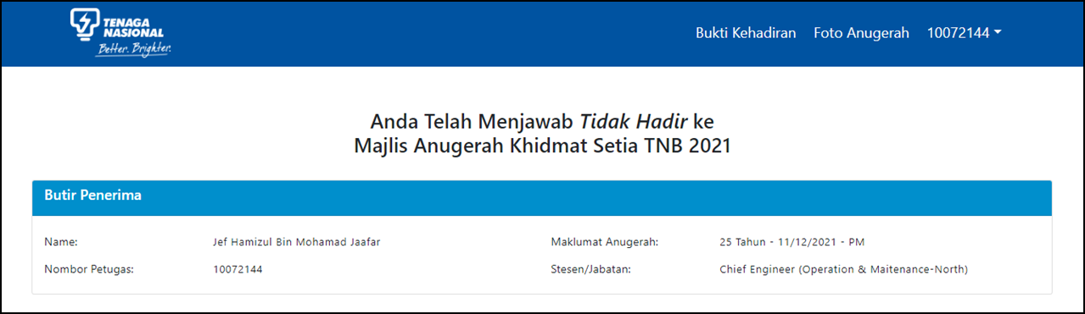
Tidak Hadir Display
Coding Page
File Location
TnbAksMs/Client/Pages/Sr/Feedback.razor

Slide 23
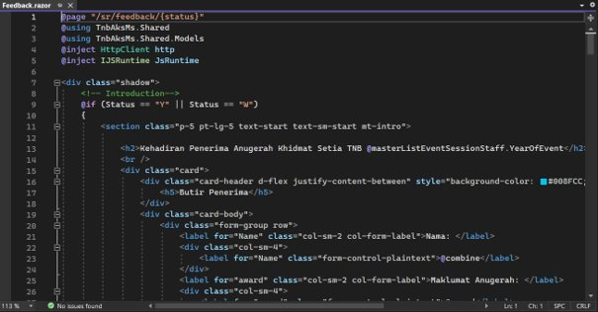
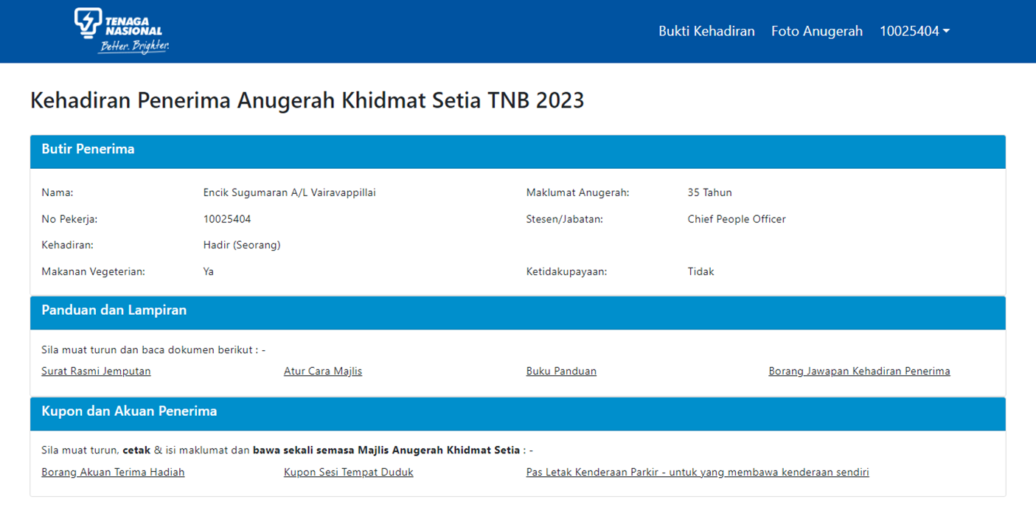
Recipient’s Photo
Coding Page
File Location
TnbAksMs/Client/Pages/Sr/Feedback.razor

Slide 24
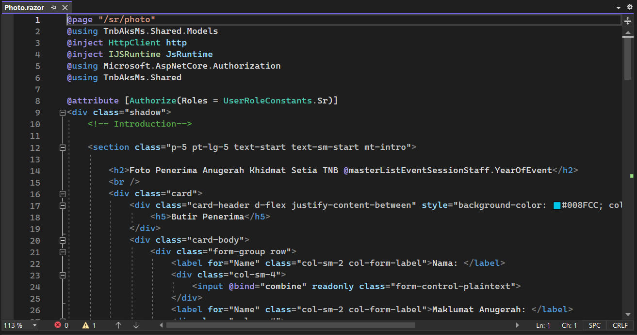
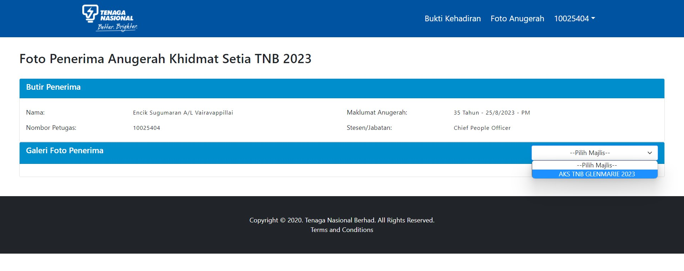
Display Image Of Staff
Coding Page
File Location
TnbAksMs/Client/Pages/Sr/Photo.razor

Slide 25
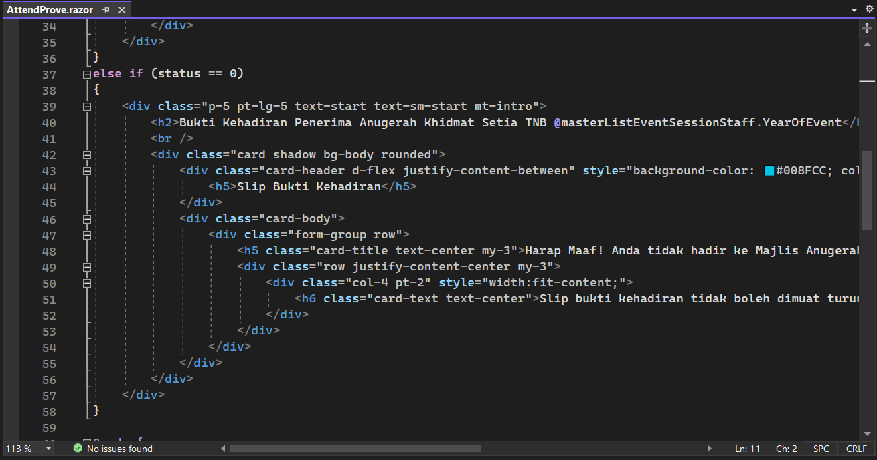
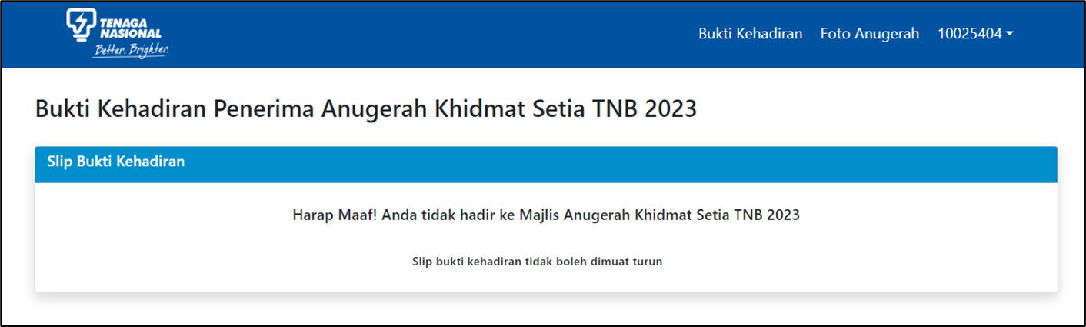
Tidak Hadir Page
Coding Page
File Location
TnbAksMs/Client/Pages/Sr/AttendProve.razor

Slide 26
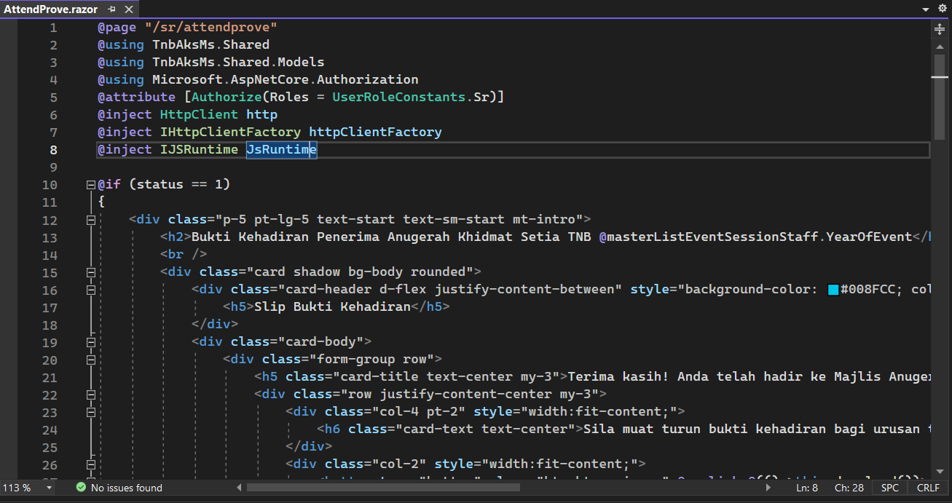
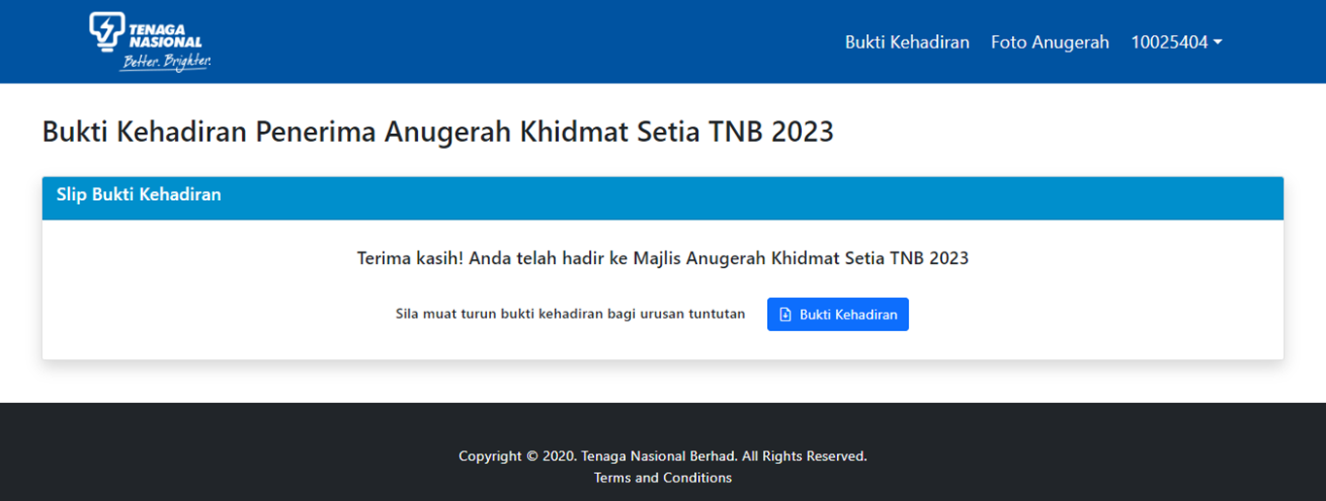
Hadir Page
Coding Page
File Location
TnbAksMs/Client/Pages/Sr/AttendProve.razor

Slide 27
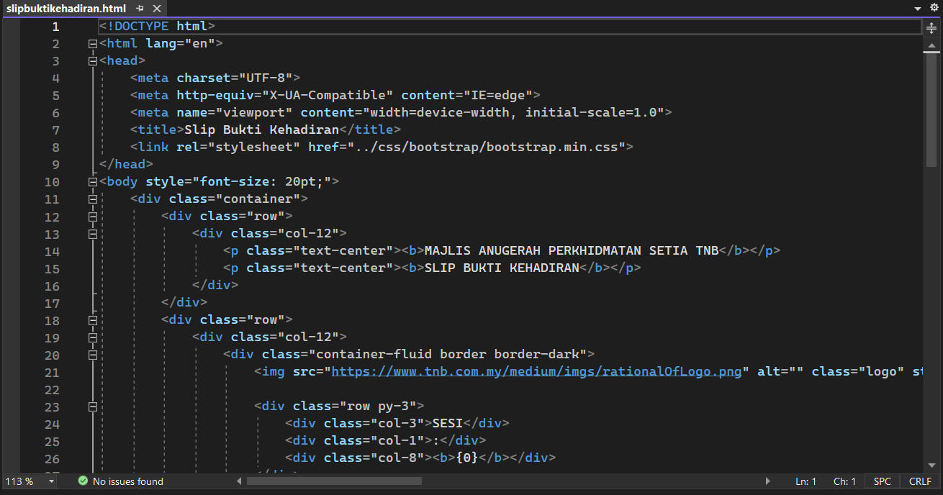
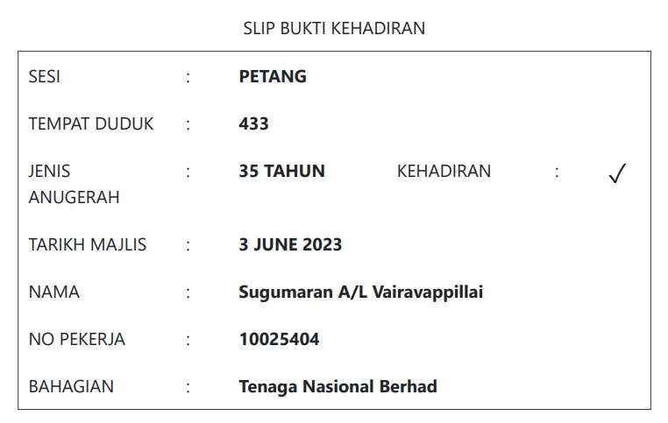
Pdf Slip Bukti Kehadiran
Coding Page
File Location
TnbAksMs/Client/wwwroot/Templates/slipbuktikehadiran.html

Slide 28
Admin & HR
CODING PAGE AKS AND FILE LOCATION

Slide 29
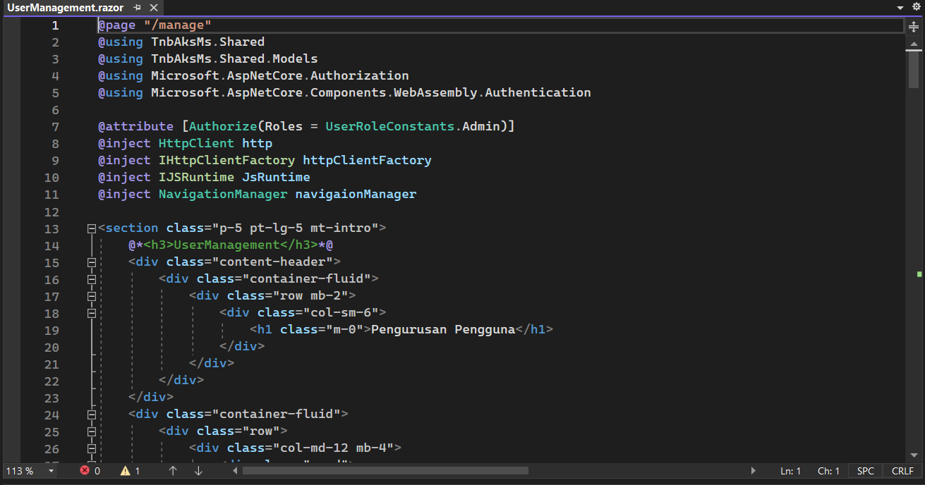
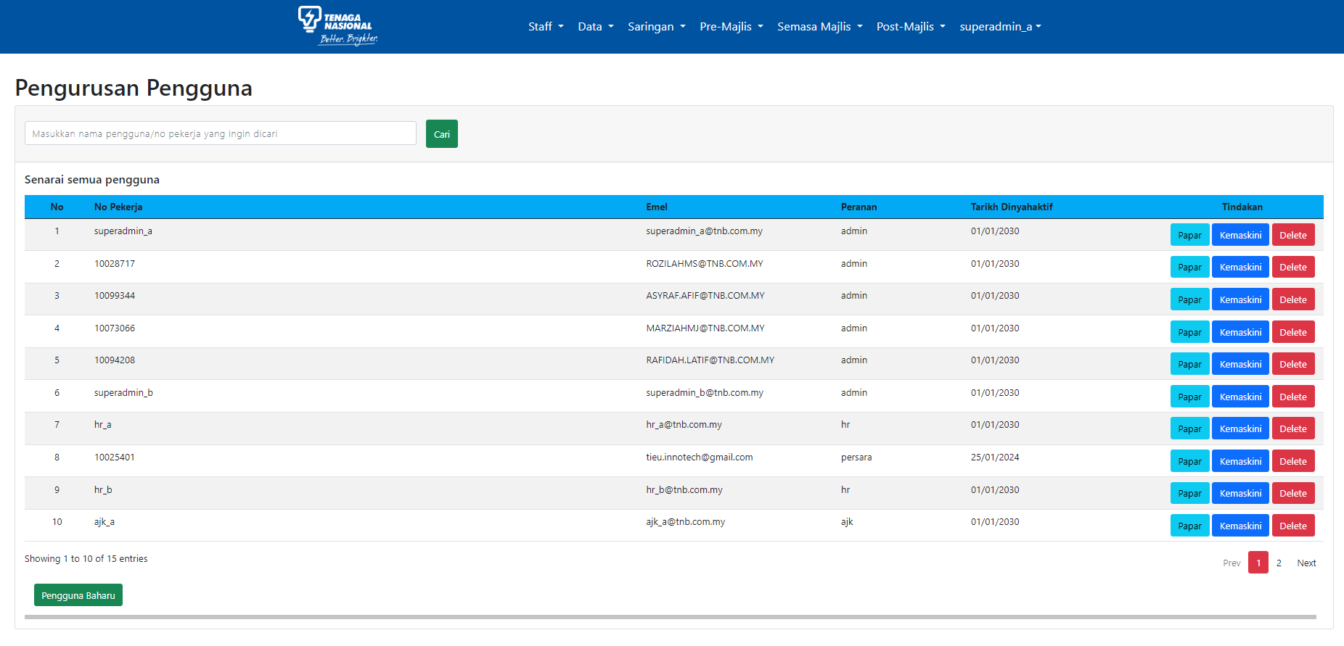
User Management
Coding Page - Admin
File Location

Slide 30
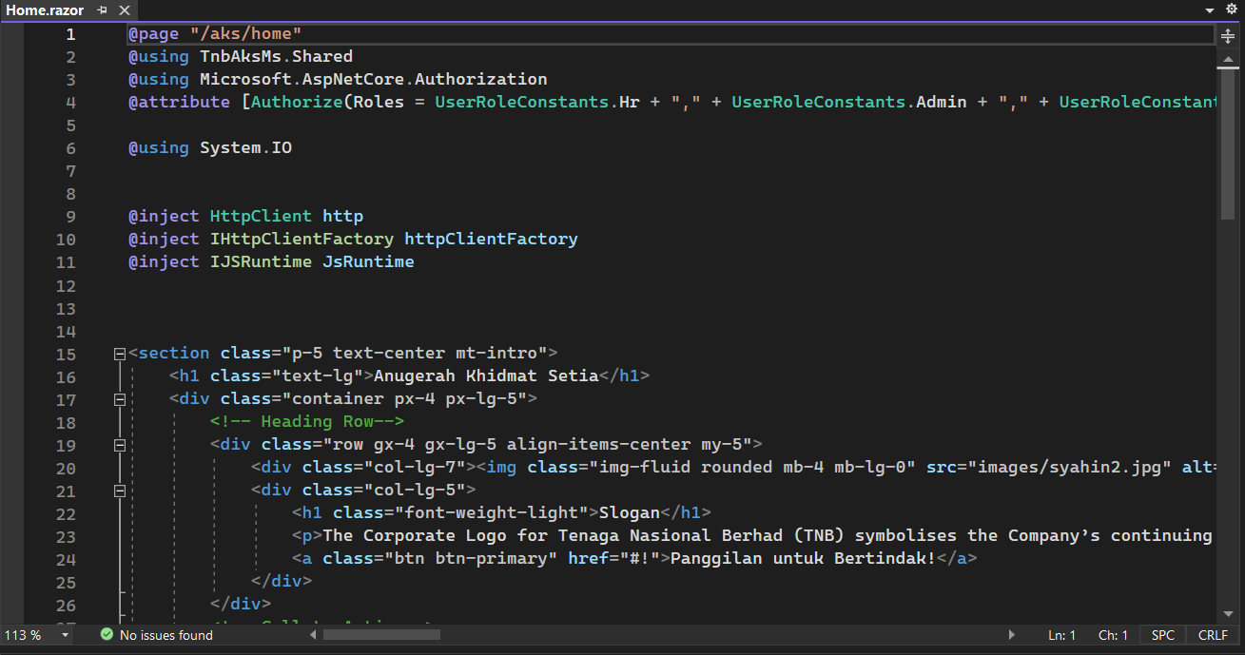
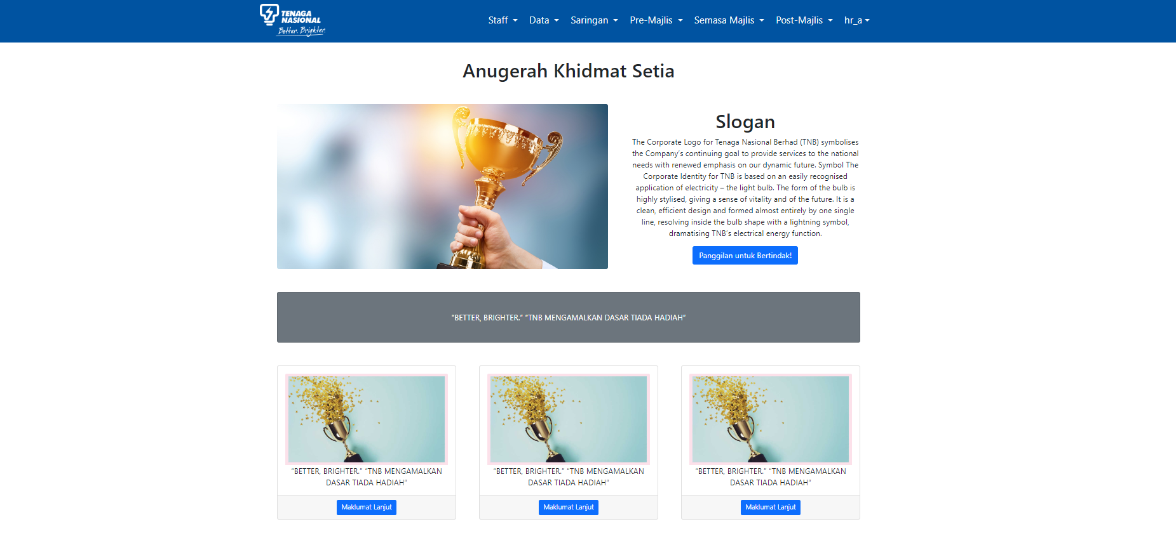
HR Main Page
Coding Page- HR
File Location
TnbAksMs/Client/Pages/Hr/Home.razor

Slide 31
Navigation-Staff

Slide 32
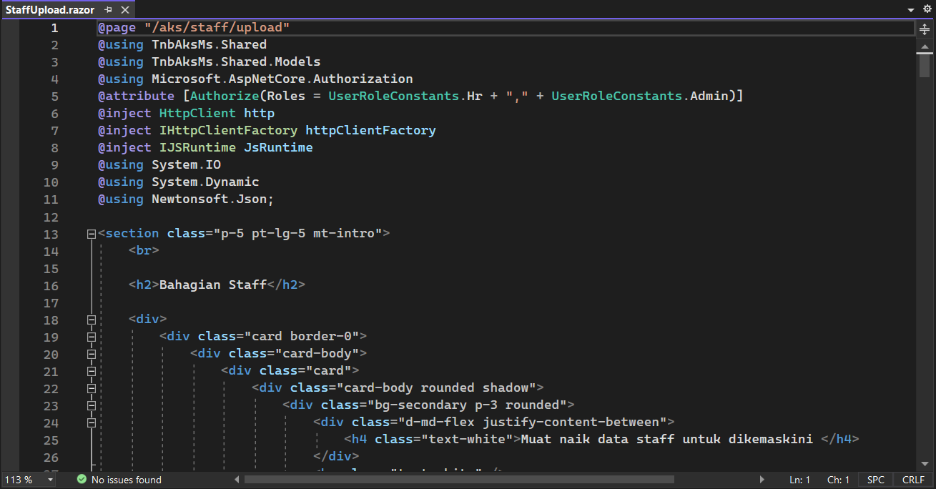
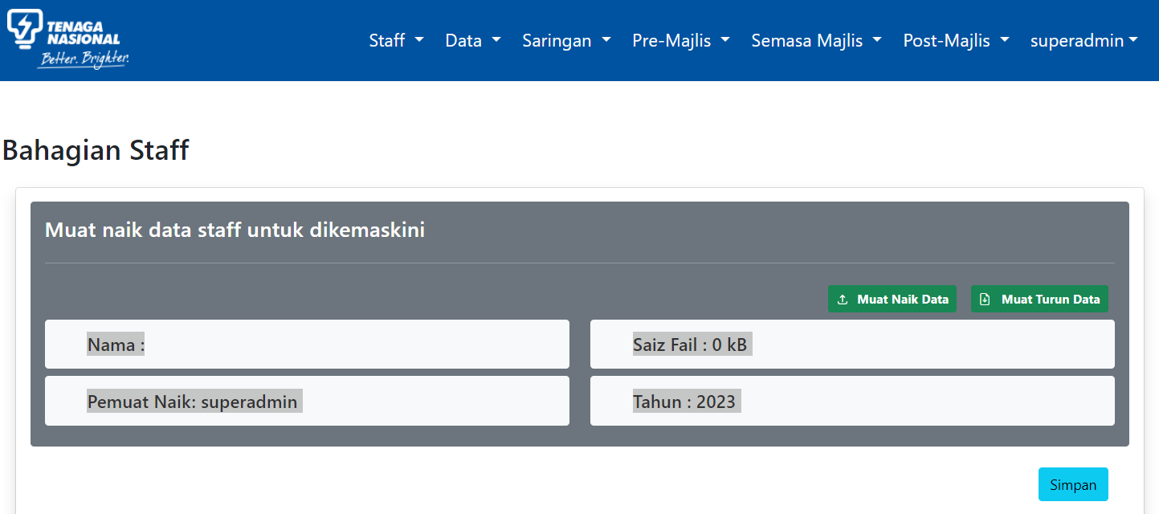
Upload Latest Staff Screen
Coding Page
File Location
TnbAksMs/Client/Pages/Hr/Staff/StaffUpload.razor

Slide 33
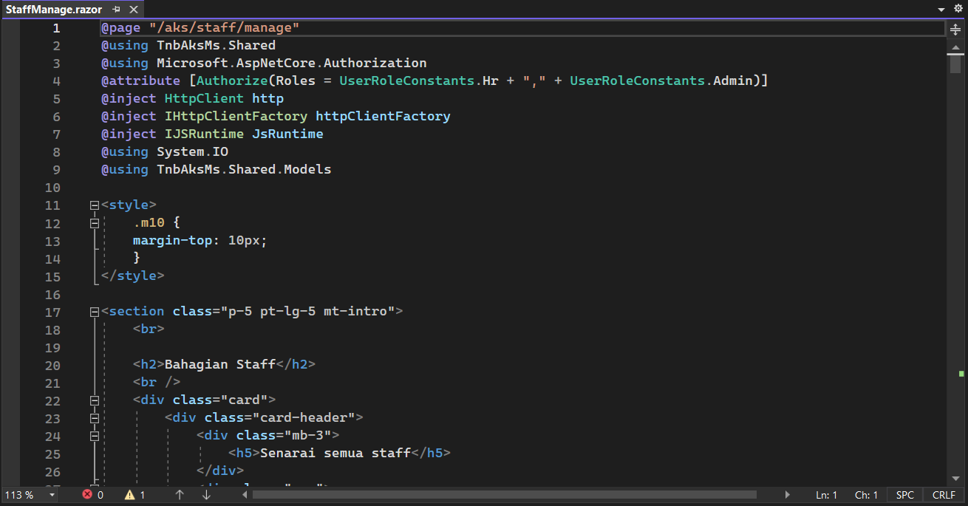
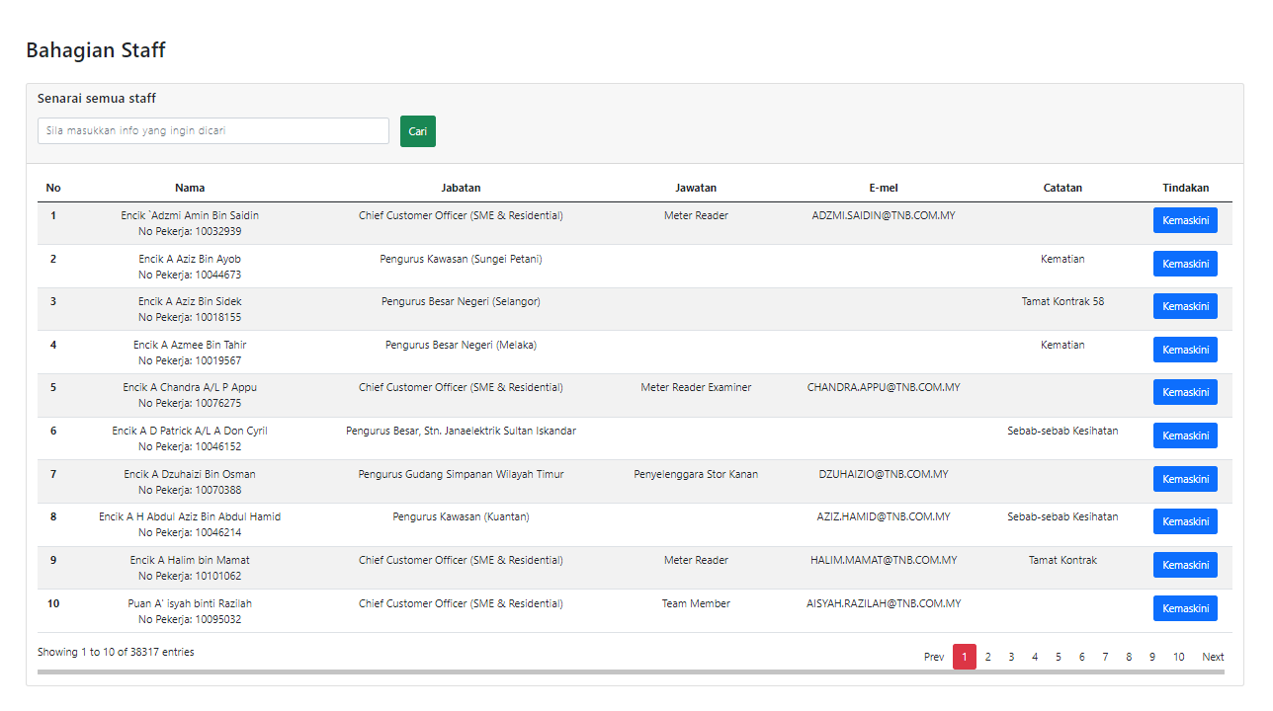
Staff List
Coding Page
File Location
TnbAksMs/Client/Pages/Hr/Staff/StaffManage.razor

Slide 34
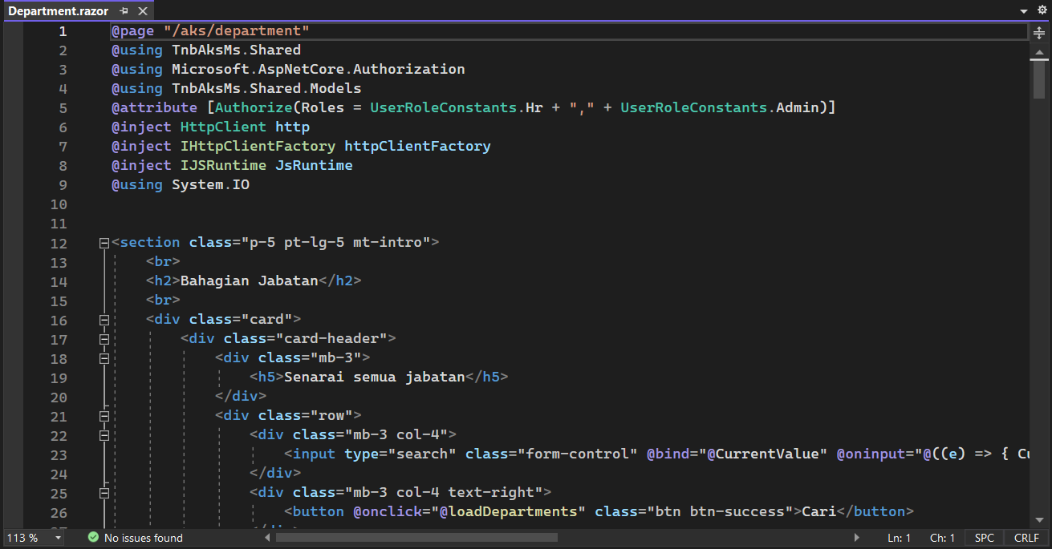
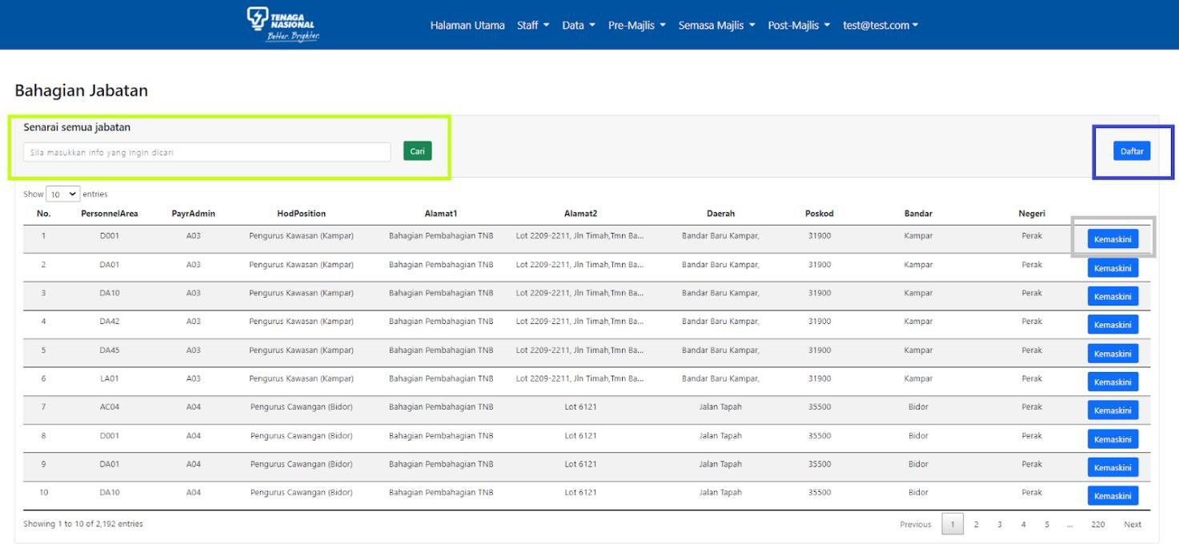
Department List
Coding Page
File Location
TnbAksMs/Client/Pages/Hr/Staff/Department.razor

Slide 35
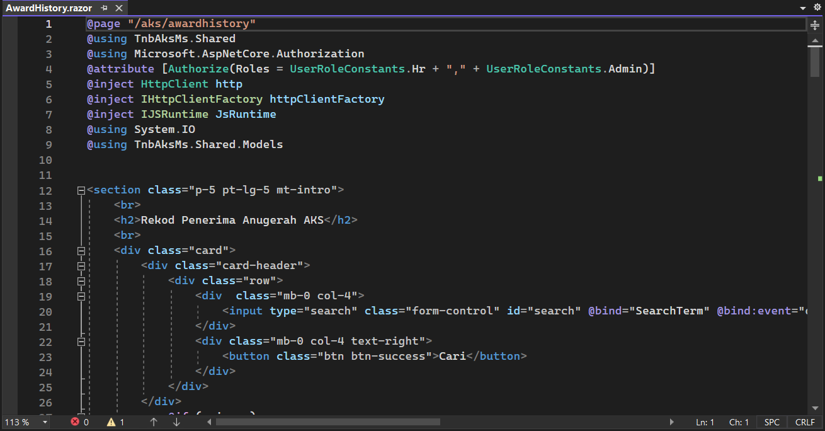
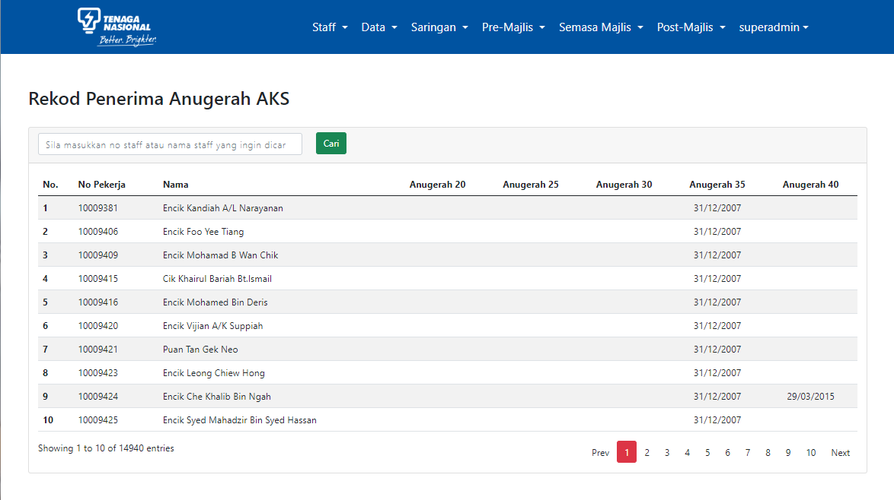
Staff Award History
Coding Page
File Location
TnbAksMs/Client/Pages/Hr/Staff/AwardHistory.razor

Slide 36
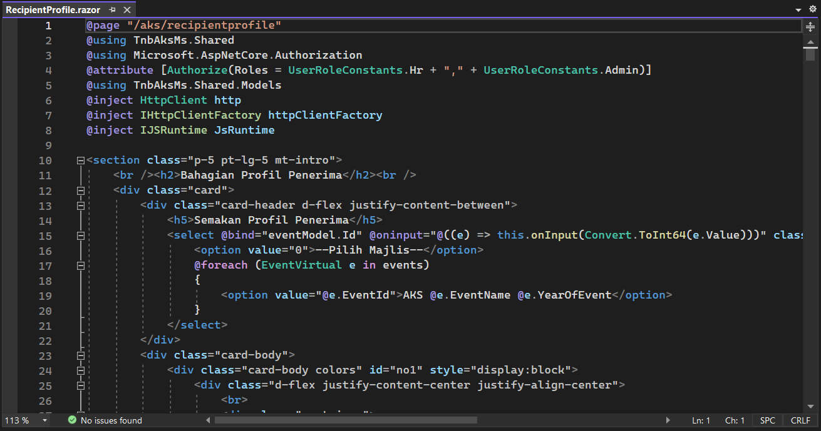
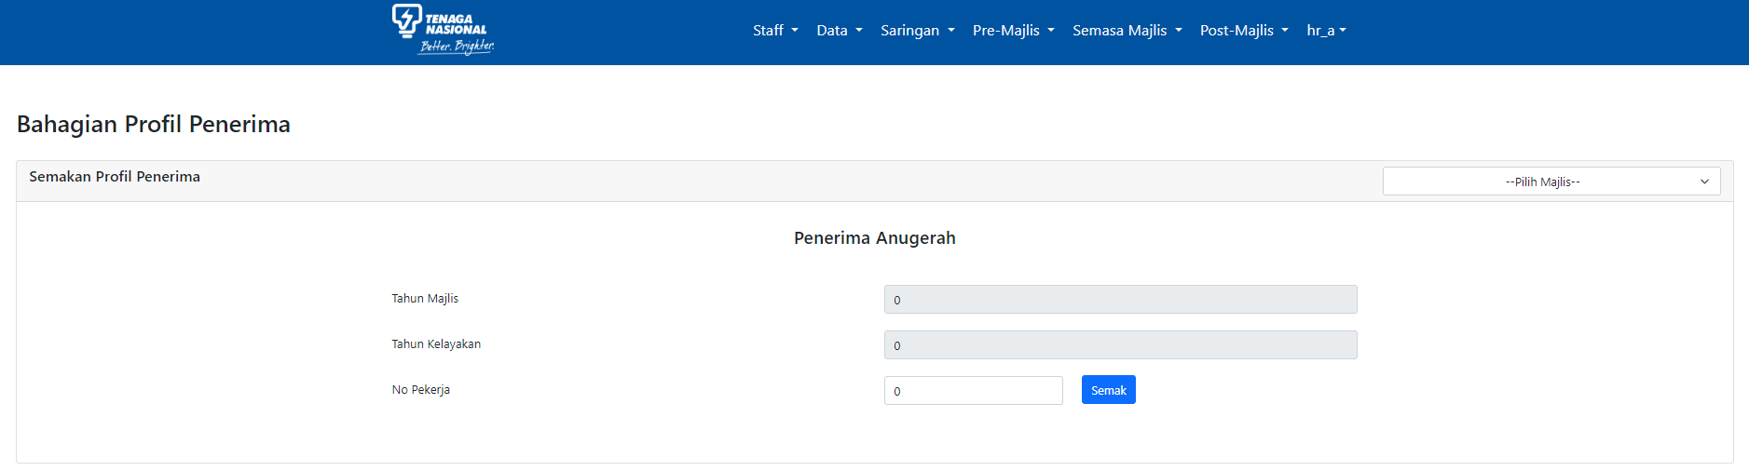
Recipient Profile
Coding Page
File Location
TnbAksMs/Client/Pages/Hr/Staff/RecepientProfile.razor

Slide 37
Navigation-Data

Slide 38
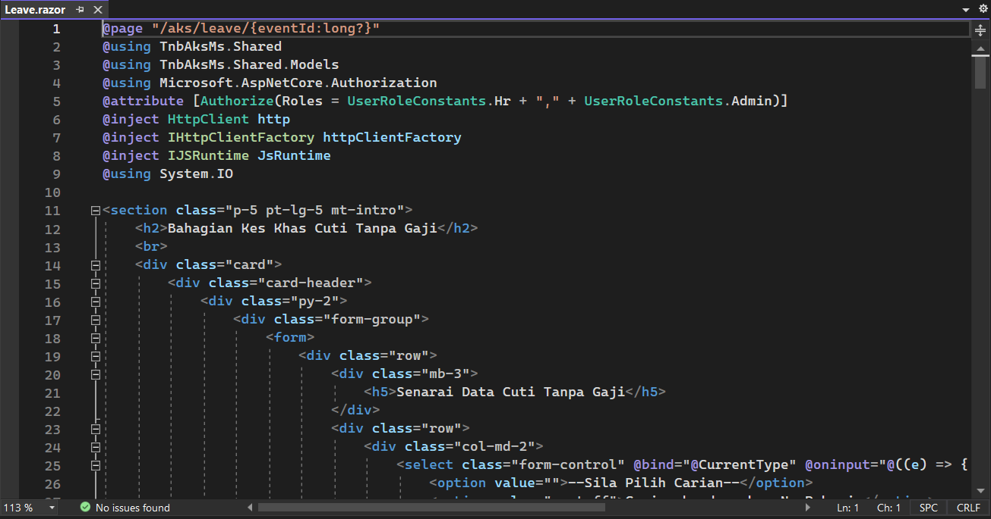
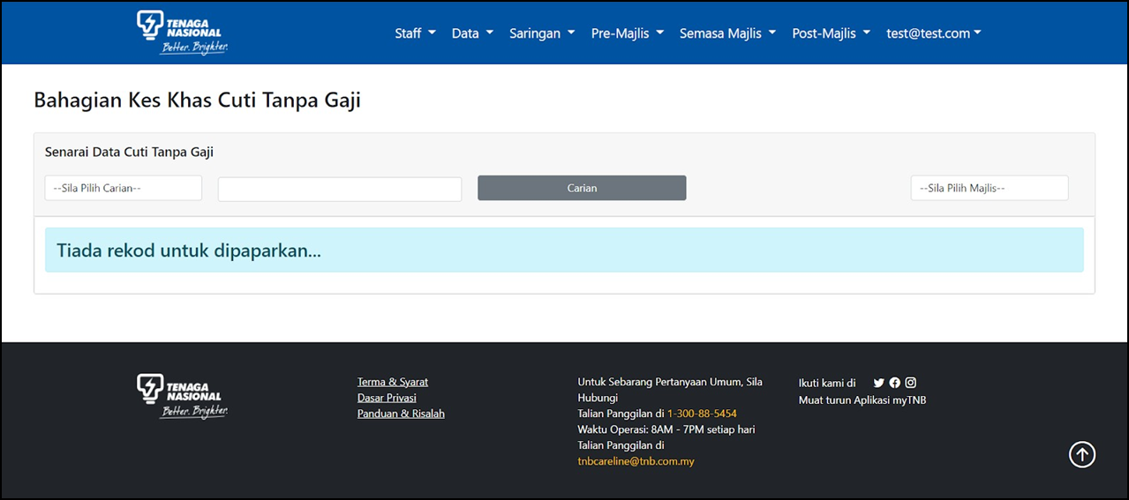
Leaves Special Case List
Coding Page
File Location
TnbAksMs/Client/Pages/Hr/Data/Leave.razor

Slide 39
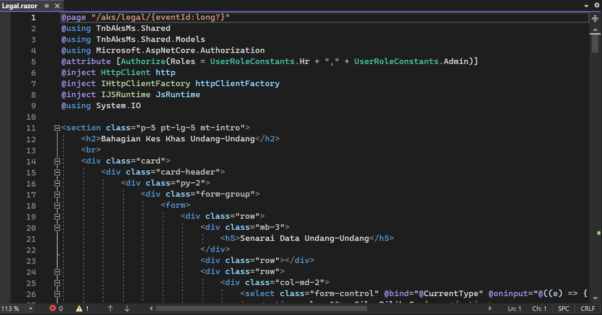

Legals Special Case List
Coding Page
File Location
TnbAksMs/Client/Pages/Hr/Data/Legal.razor

Slide 40


Discipline Special Case List
Coding Page
File Location
TnbAksMs/Client/Pages/Hr/Data/Discipline.razor

Slide 41


Masterlist List
Coding Page
File Location
TnbAksMs/Client/Pages/Hr/Data/Masterlist.razor

Slide 42
Navigation-Screening

Slide 43


Event List
Coding Page
File Location
TnbAksMs/Client/Pages/Hr/Screening/Event.razor

Slide 44


Initial Screening
Coding Page
File Location
TnbAksMs/Client/Pages/Hr/Screening/Initial.razor

Slide 45


Upload Excels
Coding Page
File Location
TnbAksMs/Client/Pages/Hr/Screening/UploadFile.razor

Slide 46


Final Screening
Coding Page
File Location
TnbAksMs/Client/Pages/Hr/Screening/Final.razor

Slide 47


Session Allocation
Coding Page
File Location
TnbAksMs/Client/Pages/Hr/Screening/Allocation.razor

Slide 48
Navigation- Pre-event

Slide 49


List of Finalized Recipients
Coding Page
File Location
TnbAksMs/Client/Pages/Hr/Pre/Recipient.razor

Slide 50


Event Tentative
Coding Page
File Location
TnbAksMs/Client/Pages/Hr/Pre/Tentative.razor

Slide 51


Attendance Confirmation Feedback
Coding Page
File Location
TnbAksMs/Client/Pages/Hr/Pre/RecipientList.razor

Slide 52


Pre-Event Statistic- Statistic of Recipients
Coding Page
File Location
TnbAksMs/Client/Pages/Hr/Pre/StatisticRecipient.razor

Slide 53


Pre-Event Statistic- Statistic of Attendance Reply Feedback
Coding Page
File Location
TnbAksMs/Client/Pages/Hr/Pre/StatisticAttendance.razor

Slide 54
Navigation- During Event

Slide 55


Attendance Confirmation During Event
Coding Page
File Location
TnbAksMs/Client/Pages/Hr/During/Attendance.razor

Slide 56


Attendance Statistic for All Eligible During Event
Coding Page
File Location
TnbAksMs/Client/Pages/Hr/During/Statistic.razor

Slide 57


Unclaimed Gifts Statistic During Event
Coding Page
File Location
TnbAksMs/Client/Pages/Hr/During/Report.razor

Slide 58
Navigation- Post-Event

Slide 59


List of Finalized Recipients’ Attendance
Coding Page
File Location
TnbAksMs/Client/Pages/Hr/Post/Report.razor

Slide 60


Event Gallery
Coding Page
File Location
TnbAksMs/Client/Pages/Hr/Post/Gallery.razor

Slide 61
List of TOTK
Backend: copy aturcara and paste for next sesi
Backend: Banner or poster on email to All recipient : TNB ICT will add/change the design
Wording in email for All recipient, ICT can change
Upload all pictures
All backend upload for 60k Data, 3 special case upload, List Jabatan
Editing information in profile penerima

Slide 62
System Information

Slide 63
Development/Staging App Server
Server Credential
Hostname | TNBSTGAKSAP.tnb.my
IP Address | 10.215.128.34
Username | TNB\admin.aks
Password | egPDV6DUUP8wYyW$
Server Specification
Operating System | Windows Server 2019
CPU | 2 Core
Memory (RAM) | 4 GB
Storage | 100 GB
Application Specification
Web Server | IIS Web Server
Deployment Directory | D:\Hosting\AKS_Staging
Application Domain | https://aks-training.tnb.com.my

Slide 64
Development/Staging DB Server
Server Credential
Hostname | TNBSTGAKSDB.tnb.my
IP Address | 10.215.126.34
Username | TNB\admin.aks
Password | egPDV6DUUP8wYyW$
Server Specification
Operating System | Windows Server 2019
CPU | 2 Core
Memory (RAM) | 8 GB
Storage | 130 GB
Database Credential
Host | 10.215.126.34
Username | aks_user
Password | 1234567890@Az
Database Name | AKSDB

Slide 65
Production App Server
Server Credential
Hostname | TNBPRDAKSAP.tnb.my
IP Address | 10.216.128.44
Username | TNB\admin.aks
Password | egPDV6DUUP8wYyW$
Server Specification
Operating System | Windows Server 2019
CPU | 4 Core
Memory (RAM) | 8 GB
Storage | 100 GB
Application Specification
Web Server | IIS Web Server
Deployment Directory | D:\Hosting\AKS_Production
Application Domain | https://aks.tnb.com.my

Slide 66
Production DB Server
Server Credential
Hostname | TNBPRDAKSDB.tnb.my
IP Address | 10.216.126.44
Username | TNB\admin.aks
Password | egPDV6DUUP8wYyW$
Server Specification
Operating System | Windows Server 2019
CPU | 4 Core
Memory (RAM) | 8 GB
Storage | 130 GB
Database Credential
Host | 10.216.126.44
Username | aks_user
Password | 12345678901@Az
Database Name | AKSDB

Slide 67

1. Latest patch in AKS Development

Slide 68

2. ERD Database Relationship

Slide 69

The date modified of the staging's files are later than the production's. Hence, the staging's version are up to date as the production's

Slide 70
Thank You

